Slide 1
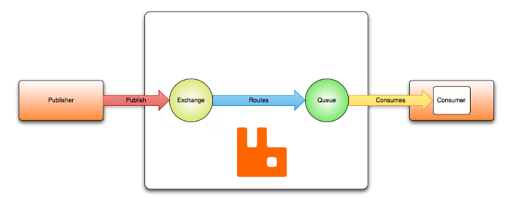
AMQP 0-9-1 Model
AMQP 0-9-1 (Advanced Message Queuing Protocol) is a messaging protocol that enables conforming client applications to communicate with conforming messaging middleware brokers.
Messaging brokers receive messages from publishers (applications that publish them, also known as producers) and route them to consumers (applications that process them).
Since it is a network protocol, the publishers, consumers and the broker can all reside on different machines.

Slide 2
AMQP 0-9-1 Model
messages are published to exchanges, which are often compared to post offices or mailboxes. Exchanges then distribute message copies to queues using rules called bindings. Then AMQP brokers either deliver messages to consumers subscribed to queues, or consumers fetch/pull messages from queues on demand.
Networks are unreliable and applications may fail to process messages therefore the AMQP model has a notion of message acknowledgements: when a message is delivered to a consumer the consumer notifies the broker, either automatically or as soon as the application developer chooses to do so. When message acknowledgements are in use, a broker will only completely remove a message from a queue when it receives a notification for that message (or group of messages).
In certain situations, for example, when a message cannot be routed, messages may be returned to publishers, dropped, or, if the broker implements an extension, placed into a so-called "dead letter queue". Publishers choose how to handle situations like this by publishing messages using certain parameters.
Queues, exchanges and bindings are collectively referred to as AMQP entities.

